Slide 1
How to install Unity 3D
SoftUni Unity 3D Basics Course
SoftUni Team
Technical trainers
Software University
https://softuni.org

Slide 2
Download Unity Hub
Go to https://public-cdn.cloud.unity3d.com/hub/prod/UnityHubSetup.exe
What is UnityHub?
Manage editors' and platforms installation.
Access to your local projects.
Manage Unity licenses.

Slide 3
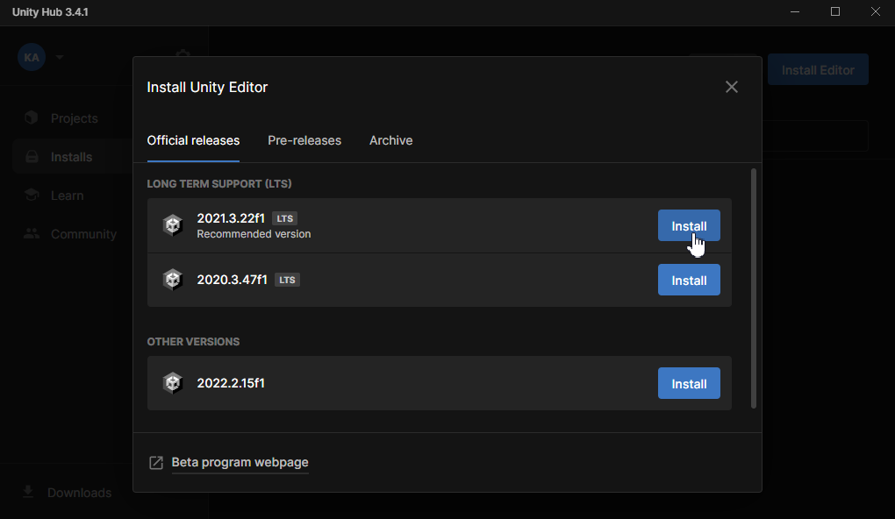
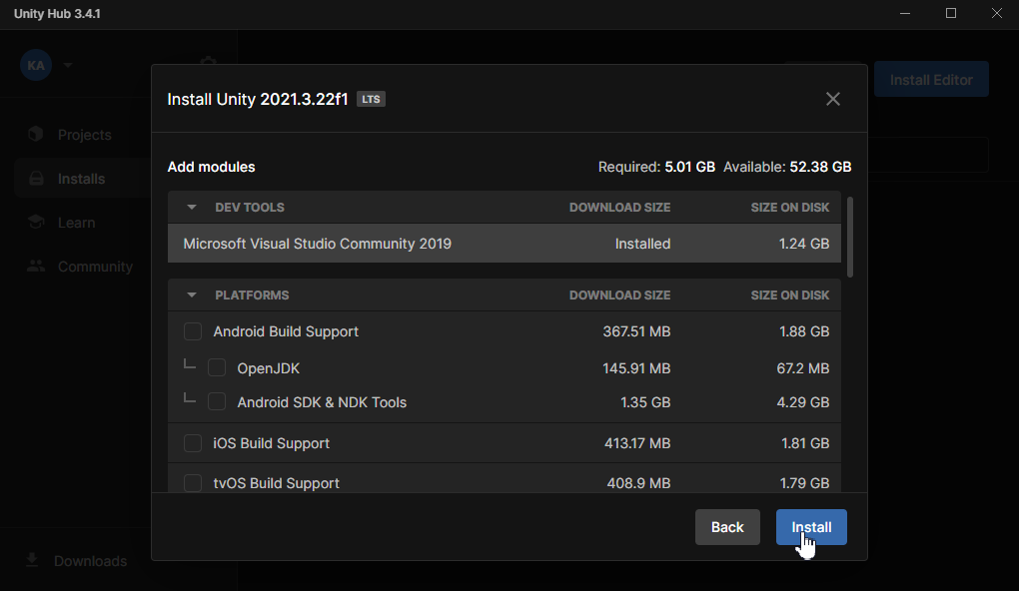
Installing the Unity Engine and its modules
Start Unity Hub
Go to Installs
Press “Install Editor”
Choose Unity version 2021.3.22f1 LTS (Long Term Support)
Check the following modules
Android Build Support
Android SDK & NDK tool
OpenJDK
If you don’t have Visual Studio Community make sure you check it as well
If you plan to build for iOS (Apple App Store) additionally check iOS Build Support

Slide 4
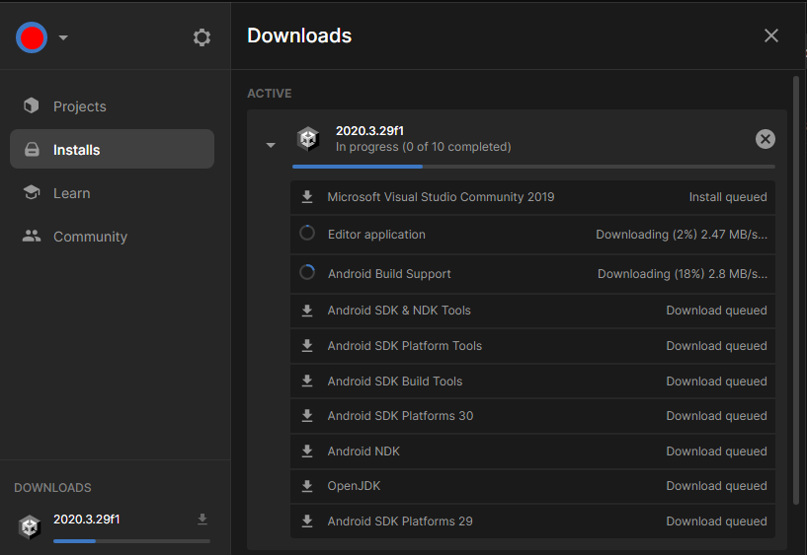
Wait for the installation to complete
Blue bar indicates the progress. It might take up to 10min
You can have multiple versions of the Unity Editor with different platform for each version.
Each project can use separate version

